Slide 1
EE227 – Digital Logic Design
Lecture 1 – 3

Slide 2
Outline
Instructor’s Introduction
Course Outline
Marks Distribution
Information Processing
Analog and Digital Quantities
Advantages of Digital System
Number Systems
Base Conversions
Complements of Numbers

Slide 3
Contact Details
Email
waqar.baig@nu.edu.pk
Office:
Room Number , EE Faculty offices
Visiting Hours:
Monday 2:00 PM – 3:00 PM
Tuesday 2:00 PM – 3:00 PM
Wednesday 2:00 PM – 3:00 PM
Or by appointment

Slide 4
Books
Text Book
“Digital Design” by M. Morris Mano, Michael Ciletti, 4th Edition
Reference Book
“Logic and Computer Design Fundamentals” by M. Morris Mano, Charles Kime

Slide 5
Course Outline
Week | Topics | Chapter
1, 2 | Introduction, Number Systems (Binary, Octal and Hexadecimal), Number Ranges, Arithmetic Operations, Conversion from Decimal to Other Bases, Negative number representations | 1
3, 4, 5 | Binary Logic and Gates, Boolean Algebra, Standard Forms, Map Simplification, Map Manipulation, Don’t-Care Conditions, NAND, NOR & Exclusive-OR Gates & Circuits, Integrated Circuits, Positive & Negative Logic | 2, 3
6, 7, 8 | Combinational Circuits, Analysis Procedure, Design Procedure, Decoders, Encoders, Priority Encoders, Multiplexers, Demultiplexers, Binary Adders (Half, Full, Ripple Carry, Carry Lookahead), Binary Subtraction, Signed Binary Numbers, Overflow | 4
9, 10, 11 | Sequential Circuits, Latches, Flip-Flops, Sequential Circuit Analysis, State Diagram, Sequential Circuit Design (with D Flip-Flops, JK Flip-Flops, T flip flops), word problems | 5
12, 13, 14 | Registers and Counters, Register with Parallel Load, Shift Registers, Shift Register with Parallel Load, Bidirectional Shift Register, Ripple Counter, Synchronous Binary Counters, Serial and Parallel Counters, Up-Down Binary Counter, Binary Counter with Parallel Load. Miscellaneous Counters (BCD Counters, Arbitrary Sequence Counters) | 6
15, 16 | Memory and Programmable Logic Devices, Random-access Memory, Dynamic RAM ICs, Programmable Logic Technologies (Read-only Memory, Programmable Logic Arrays, Programmable Array Logic Devices, FPGAs) | 7

Slide 6
Marks Distribution
Mid Term I 15%
Mid Term II 15%
Quizzes 10 – 15%
Assignment/Project 5 – 10%
Final Exam 50%

Slide 7
Attendance Policy
In order to appear in final exam, 80% attendance is must, and there will be zero tolerance on attendance
Attendance will be called at the start of every class and you will be marked as absent if you are more than 10 minutes late
Only excuses obtained officially are accepted. Personal excuses are not accepted. No make-up tests/quizzes/exams will be provided until instructed by academic committee

Slide 8
General Guidelines
Some quizzes will be unannounced
The environment of class will be friendly but we have to respect the environment of the class
You are free to ask relevant questions during the lecture
Use of mobile phones/tablets/laptops in the class is strictly not allowed
Grading scheme will be decided according to class performance
Partially or fully copied assignments/reports will be marked as ZERO
There will be no extension in the deadlines

Slide 9
Now Lets Start the Course
☺

Slide 10
Information Processing
In our daily life we have to process the following types of data
Text
Numbers
Formulas and Equation
Pictures
Audio
Video
All above can be divided in two categories
Analog
Digital

Slide 11
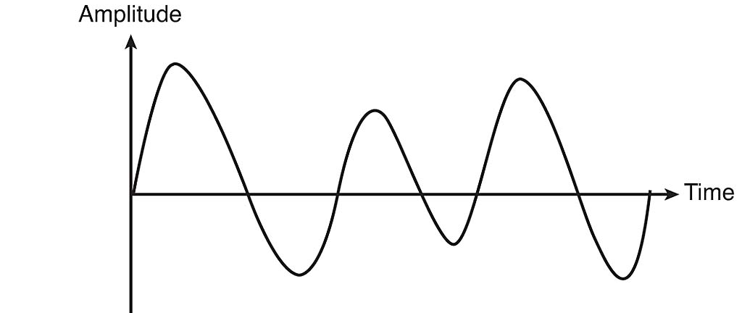
Analog Quantities
Continuous in nature
Intensity of light
Temperature
Velocity

Slide 12
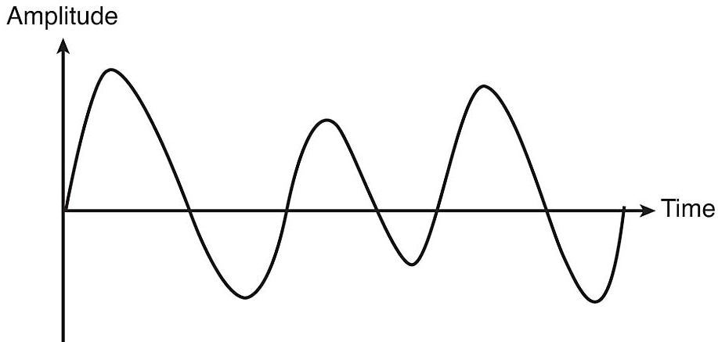
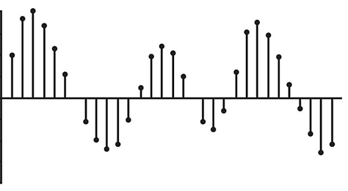
Digital Quantities
Discrete set of values
Can be obtained by sampling of analog signals

Slide 13
Advantages of using Digital System
Efficient Processing & Data Storage
Efficient & Reliable Transmission
Detection and Correction of Errors
Precise & Accurate Reproduction
Easy Design and Implementation
Occupy minimum space
Digital Systems are programmable
Overall cost of system is less

Slide 14
Why Digital Logic Design is Important?
A digital system is an interconnection of digital modules
To understand the operation of each digital module, it is necessary to have a basic knowledge of digital circuits and their logical function

Slide 15
Data Representation
Four basic data representation techniques
Binary (base 2)
Octal (base 8)
Decimal (base 10)
Hexadecimal (base 16)
System | Base | Possible Digits
Binary | 2 | 0 1
Octal | 8 | 0 1 2 3 4 5 6 7
Decimal | 10 | 0 1 2 3 4 5 6 7 8 9
Hexadecimal | 16 | 0 1 2 3 4 5 6 7 8 9 A B C D E F
For a valid representation the digits used must be less than the Base

Slide 16
Binary Number System (1/2)
Data is represented with two possible states
Digits 1 and 0 are used to represent
1 → True
0 → False
Numbers are stored as sequence of 1s and 0s
0 0 1 0 1 0 1 0 1 0 1 1 0 1 1 1
Leftmost bit is call Most Significant Bit (MSB)
Rightmost bit is called Least Significant Bit (LSB)
MSB
LSB

Slide 17
Binary Number System (2/2)
Each bit is either 0 or 1
The weight of each bit is the power of 2
Bit number starts from 0
And counting starts from LSB
Bits 1 1 1 1 1 1 1 1
Weight 2⁷ 2⁶ 2⁵ 2⁴ 2³ 2² 2¹ 2⁰
Weight 128 64 32 16 8 4 2 1

Slide 18
Signed and Unsigned Binary Numbers
Binary integers can be signed or unsigned
Signed integers, as evident from name, are either positive or negative
Unsigned integers are by default positive

Slide 19
Hexadecimal Number System
Used to represent large binary numbers
Digits 0 to 15 are used in hexadecimal notation where 10 is A, 11 is B, 12 is C, 13 is D, 14 is E, and 15 is F
Commonly used to represent memory addresses
The weight of each digit is the power of 16

Slide 20
Decimal and Octal Number System
In decimal number system there are 10 possible digits (0 – 9)
The weight of each digit is the power of 10
For example (9874)₁₀ is a number in decimal number system
In Octal number system there are 8 digits (0 – 7 )
The weight of each digit is the power of 8
For example the number (7301)₈ is a number is octal system

Slide 21
Base Conversions
We will discuss the following base conversions during this course
Conversions of unsigned numbers
Conversions of fractions
Conversions of signed numbers

Slide 22
Unsigned Binary Integers to Decimal
Weighted Positional Notation method
D = binary digit
n = bit position number in binary number
Example
Convert 11010 to decimal
Convert 11001110 to decimal
Dec = (D_{n-1} x 2^{n-1}) + (D_{n-2} x 2^{n-2}) + . . . + (D₁ x 2¹) + (D₀ x 2⁰)

Slide 23
Decimal to Unsigned Binary Conversion
Repeatedly divide the decimal integer by 2 until the quotient is 0
The combination of remainders makes the binary number
The first remainder goes at LSB position and last remainder goes at MSB position
Example
Convert 25 from decimal to binary
Convert 115 from decimal to binary

Slide 24
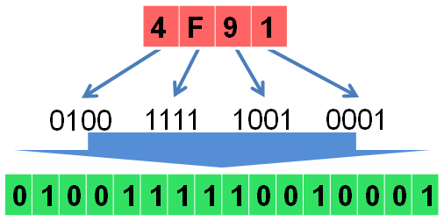
Hexadecimal to Binary
Each hexadecimal integer corresponds to 4 binary bits
Convert each hexadecimal number to corresponding binary number
Example
Convert 4F91 to binary

Slide 25
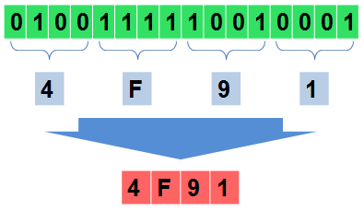
Binary to Hexadecimal
Starting from right convert each 4 bits of binary into its corresponding hexadecimal
If there are less than 4 bits remaining in the end then append zeros to complete the group of 4
Example
Convert 0100 1111 1001 0001 to hexadecimal

Slide 26
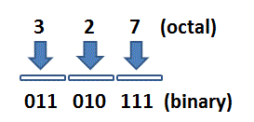
Octal to Binary
Each octal integer corresponds to 3 binary bits
Convert each octal number to corresponding binary number
Example
Convert 327 to binary

Slide 27
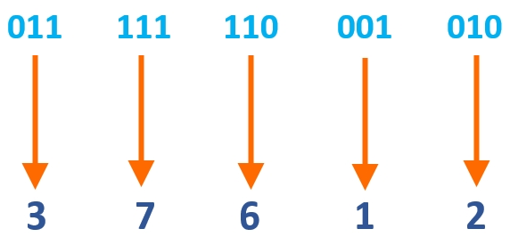
Binary to Octal
Starting from right convert each 3 bits of binary into its corresponding octal value
If there are less than 3 bits remaining in the end then append zeros to complete the group of 3
Example
Convert 11 111 110 001 010 to Octal

Slide 28
Hexadecimal to Decimal
Multiply each hexadecimal digit with its corresponding power of 16
D = hexadecimal digit
n = digit position number in hexadecimal number
Example
Convert 3BA4 to decimal
Convert 23AB to decimal
Dec = (D_{n-1} x 16^{n-1}) + (D_{n-2} x 16^{n-2}) + . . . + (D₁ x 16¹) + (D₀ x 16⁰)

Slide 29
Decimal to Hexadecimal
Repeatedly divide the decimal integer by 16 until last quotient is 0
Each remainder is a hex digit
First remainder goes at least significant position and last remainder goes at most significant position
Example
Convert 140 to Hexadecimal
Convert 396 to Hexadecimal

Slide 30
Practice Problem 1
Convert the following numbers to decimal
(123)₄
(32401)₅
(1100101)₂
Convert the following decimals numbers to indicated bases
(1254)₁₀ to base 3
(4096)₁₀ to base 16
(0362)₁₀ to base 8
Convert (2376)₈ to hexadecimal equivalent

Slide 31
Converting Fractions to Decimal
In any number system the base is also called the radix, and is represented by r
We can convert the fractions from any base to decimal by using the following relation
Example
Convert the following numbers to equivalent decimal numbers
(11010.11)₂
(4021.2)₅
(127.4)₈
Dec = (a_{n} x r^{n} + a_{n-1} x r^{n-1} + … + a₁ x r¹ + a₀ x r⁰) . (a₋₁ x r⁻¹ + a₋₂ x r⁻² + ….)

Slide 32
Converting Fractions from Decimal to Other Bases
Multiply the fractional part by radix (r), the integer part will be the first digit
Take the fractional part of the immediate product and multiply it by r again and note the next digit
Continue this process until the fractional part of the subsequent product is 0 or starts to repeat itself
For example lets convert 0.5625 to binary
The answer is (0.1001)₂
If there is an integer part then convert it separately by using the division technique

Slide 33
Practice Problem 2
Carry out the following conversions
0.513 to Octal
41.6875 to binary
(10010.100101)₂ to decimal
153.125 to octal
(10110001101011 . 11110000011)₂ to Octal
(306.D)₁₆ to binary
(673.124)₈ to binary
(10110001101011 . 1111001)₂ to Hexadecimal

Slide 34
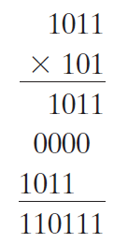
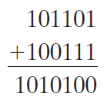
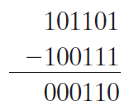
Binary Addition, Subtraction and Multiplication
Arithmetic operations with numbers in base r follow the same rules as for decimal numbers. When a base other than the familiar base 10 is used, one must be careful to use only the r‐allowable digits
Examples of addition, subtraction and multiplication in binary are given below

Slide 35
Complements of Numbers
Complements are used in digital computers to simplify the subtraction operation and for logical manipulation
Simplifying operations leads to simpler, less expensive circuits to implement the operations
There are two types of complements for each base‐r system
Radix complement (r’s complement)
Diminished radix complement (r – 1’s complement)

Slide 36
Diminished Radix Complement
Given a number N in base r having n digits, the (r - 1)’s complement of N , i.e., its diminished radix complement, is defined as (r^{n} - 1) – N
Which means, subtract each digit of the number from (r – 1)
For example the diminished radix complement of 546700 is calculated as
999999 – 546700 = 453299
In case of binary numbers it is called 1’s complement and is obtained by inverting all the bits
For example the 1’s complement of 11001 is 00110

Slide 37
Radix Complement
Radix complement is computed by adding 1 to the diminished radix complement
For example the r’s complement of 546700 is calculated as
999999 – 546700 = 453299 + 1 = 453300
In case of binary numbers it is called 2’s complement and can be calculated in two ways
Adding 1 to 1’s complement
By leaving all least significant 0’s and the first 1 unchanged and replacing 1’s with 0’s and 0’s with 1’s in all other higher significant digits
For example the 2’s complement of 1101100 is 0010100

Slide 38
Complements of Fractions
In the previous definitions, it was assumed that the numbers did not have a radix point
If the original number N contains a radix point, the point should be removed temporarily in order to form the r’s or (r - 1)’s complement
The radix point is then restored to the complemented number in the same relative position
It is also worth mentioning that the complement of the complement restores the number to its original value

Slide 39
Practice Problem 3
Find the (r – 1)’s complements of the following numbers
(23456)₈
(12004)₅
(03DBA)₁₆
(00110110)₂
(110111 . 1101)₂
Find the r’s complements of the following numbers
(11100010)₂
(00110011)₂
(89C2DF)₁₆
(042142)₅
(0723 . 6124)₈

